Slide 1
Application of machine learning tools for the analysis and prediction of wind and solar power generation
Tarek Ahmed 200108144
Md. Sabbir Hossain 200108148

Slide 2
Content
Research Goal
Introduction
Objective
Initial Idea of an ML algorithms
Literature review
The Methodology
The Process of Development
Data cleaning process
References

Slide 3
Research Goal
Develop a Machine Learning Model for Wind and Solar Power Generation Prediction
Implement Time Horizon Forecasting for Wind and Solar Power Generation
Integration and Optimization

Slide 4

Introduction
Renewable sources harness nature for electricity, offering sustainable alternatives to fossil fuels, vital for combating climate change and energy security.

Slide 5
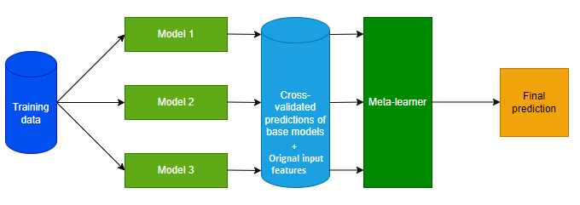
Introduction
Machine learning models analyze weather data to predict solar and wind power generation, aiding renewable energy integration and grid stability.

Slide 6
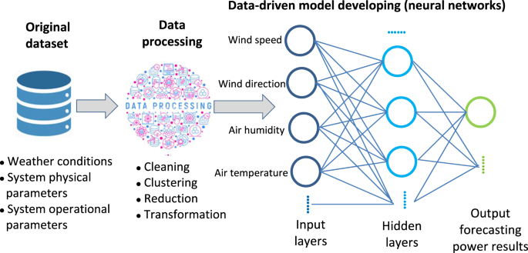
Initial Idea of an ML algorithms
Figure : Initial Idea of an ML algorithms
ML algorithms learn patterns from data to make predictions or decisions, aiding tasks like forecasting, classification, or clustering.

Slide 7
Objectives
ML algorithms predict renewable energy from meteorological data.
Forecast renewable energy at various time horizons.
Enhance grid stability, efficiency, cost savings with accurate renewable energy forecasts.

Slide 8
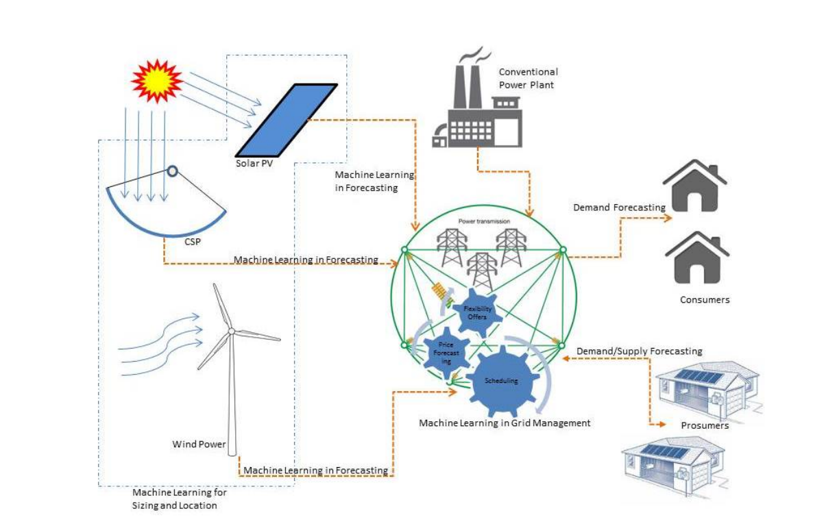
Literature Review
Review on "Machine Learning Techniques for Supporting Renewable Energy Generation and Integration: A Survey" (Paper 1)
Survey explores machine learning's role in predicting, optimizing, and integrating renewable energy sources for sustainable grid management.
Courtesy : https://scihub.se/https://doi.org/10.1016/j.triboint.2016.12.035

Slide 9
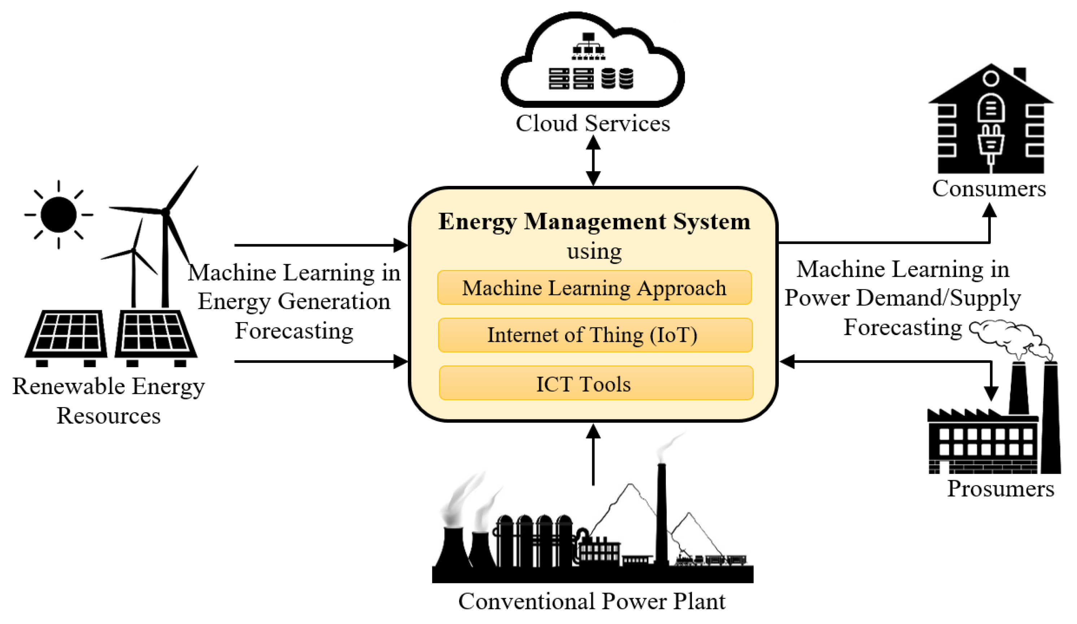
Literature Review
Review on "Machine-learning methods for integrated renewable power generation: A comparative study of artificial neural networks, support vector regression, and Gaussian Process Regression" (Paper 2)
Research investigates machine learning models (ANN, SVR, GPR) to enhance predictability of renewable energy (wind, solar) and demand, reducing reliance on costly storage and standby capacity in electricity grid.
Courtesy : https://scihub.se/https://doi.org/10.1016/j.triboint.2016.12.035,

Slide 10
Literature Review
Review on "Predicting Solar Generation from Weather Forecasts Using Machine Learning" (Paper 3)
Paper explores machine learning for site-specific solar power prediction using National Weather Service data, achieving 27% accuracy improvement.
Courtesy : https://scihub.se/https://doi.org/10.1016/j.triboint.2016.12.035,

Slide 11
Research Gap
1. Recognize limitations in current models.
2. Focus research to overcome gaps.
3. Innovate for improved accuracy and reliability

Slide 12
Methodology
Step 1
The statement of the problem
Step 2
The determination of objectives
Step 3
The process of reviewing the literature
Step 4
The formulation of methodology
Step 5
The process of Development
Step 6
The Reporting

Slide 13
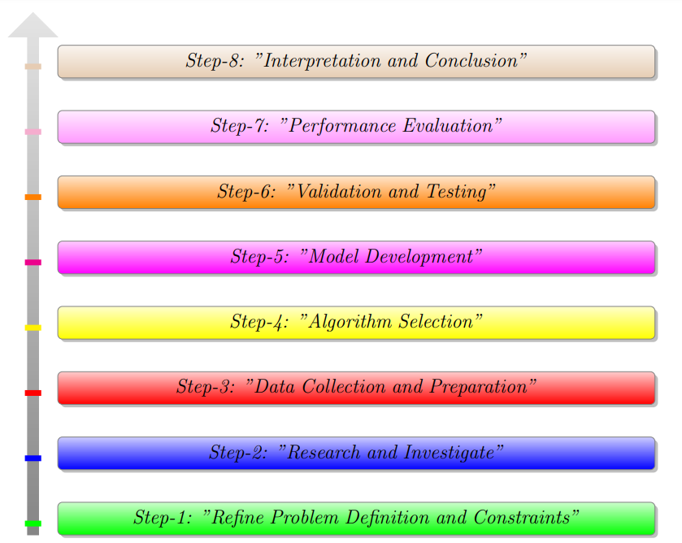
The Process of Development
Figure : Methodology of the thesis Project

Slide 14
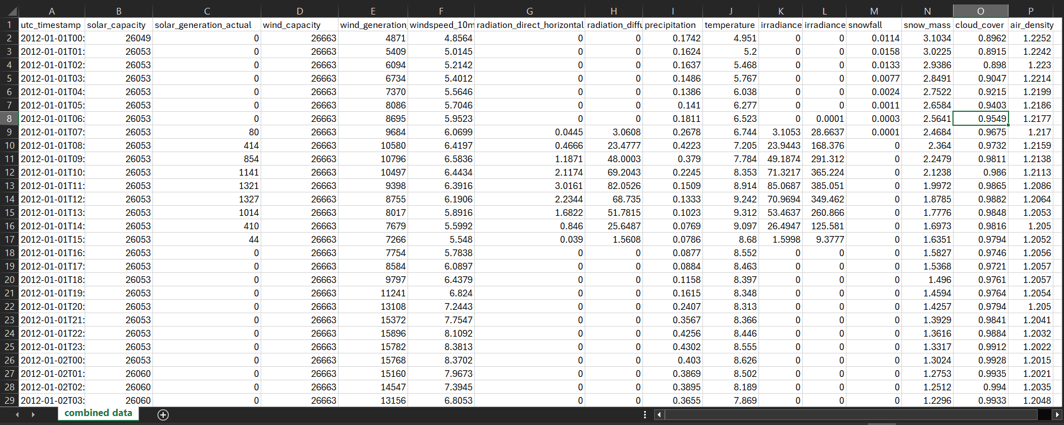
Data Collection and Preparation
Wind and solar power production data sourced from time-series records, paired with hourly weather data from Renewables.ninja using NASA MERRA-2.
Figure : Raw Data from NASA MERRA-2

Slide 15
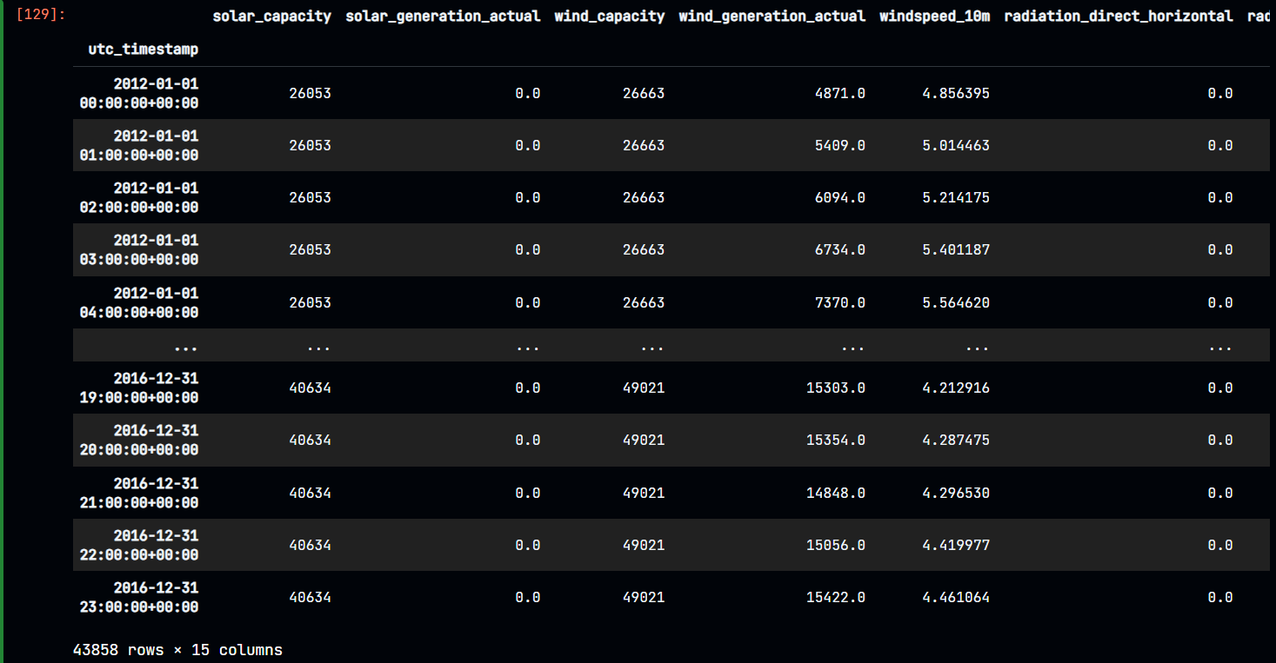
Data Cleaning Process
Here is the Final output of Data cleaning process where 43858 rows × 15 columns are present and no missing value.
Figure : Cleaned data without missing values

Slide 16
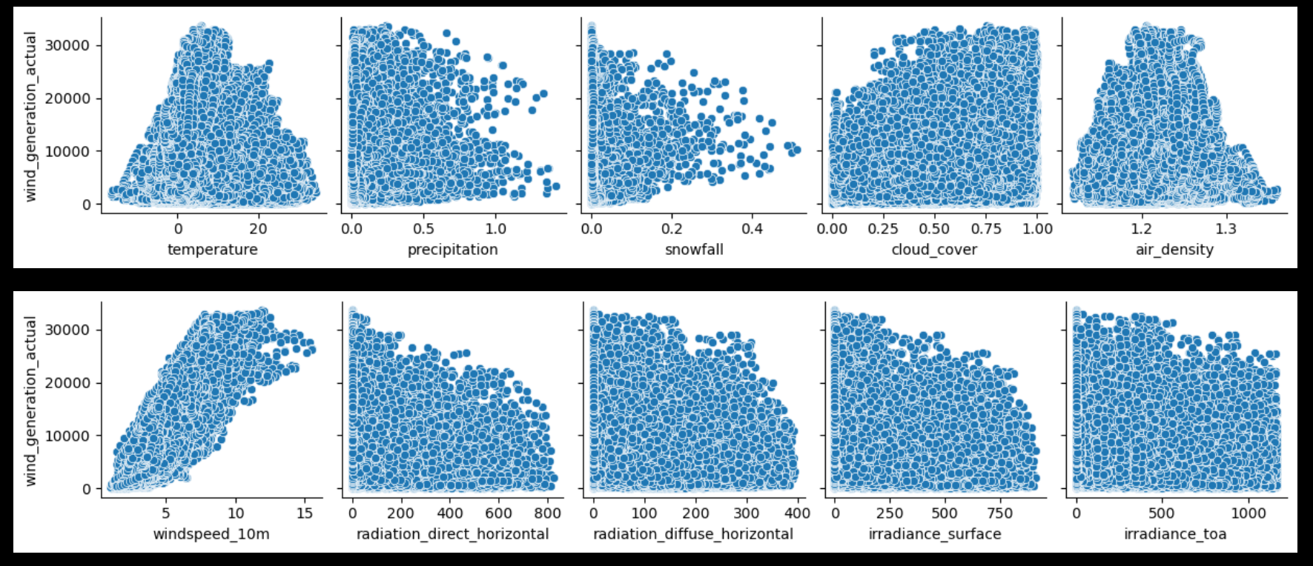
Data Cleaning Process
# Let's plot the generation of wind power (MWh) vs. weather data features
Figure : Wind power (MWh) vs. weather data features

Slide 17
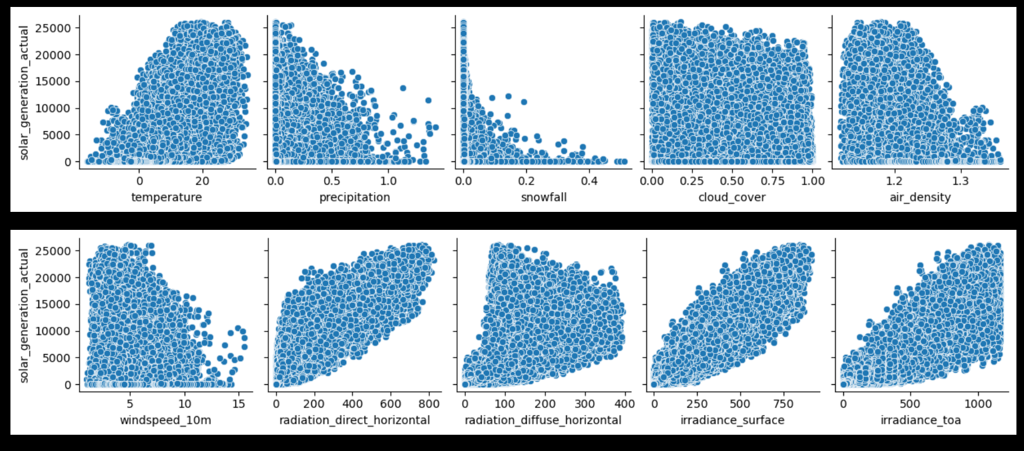
Data Cleaning Process
# Let's plot the generation of solar power (MWh) vs. weather data features
Figure : Solar power (MWh) vs. weather data features

Slide 18
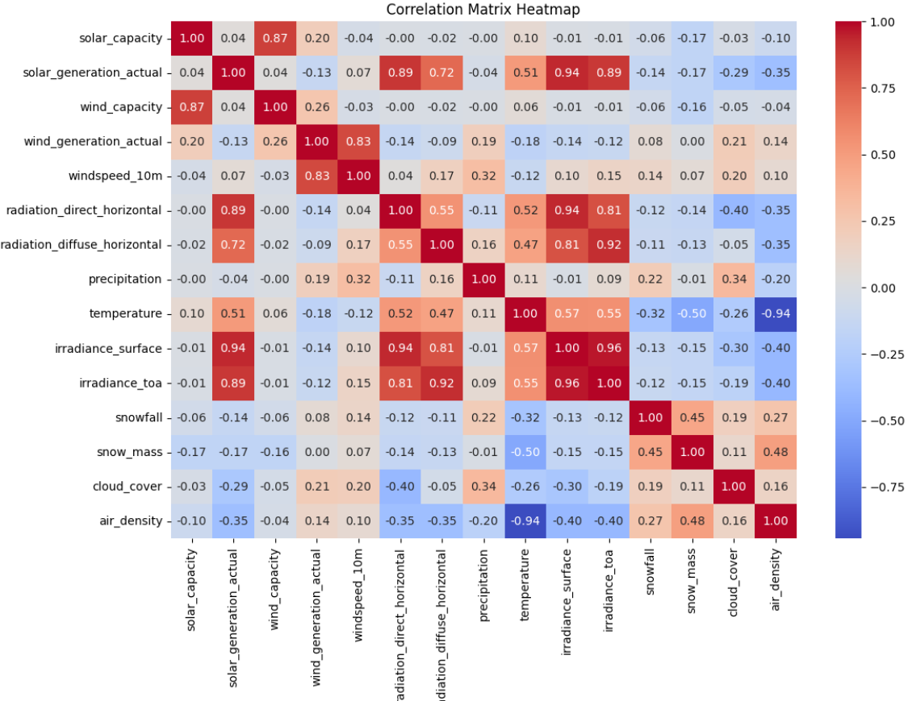
Data Cleaning Process
A correlation matrix heatmap visually represents the correlation between different variables in a dataset.
Figure : Correlation matrix heatmap

Slide 19
Algorithms
Linear Regression model
Decision Tree Regression model
Random Forest Regression model

Slide 20
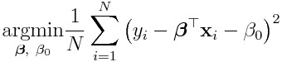
Algorithms
Linear Regression model
The Equation -
The output of a linear regression algorithm is a linear function of the input:
Where ,
The objective is to find the parameters which minimize
the mean squared error:

Slide 21
Modeling
Model training
Cross-validation
Model testing
Model tuning

Slide 22
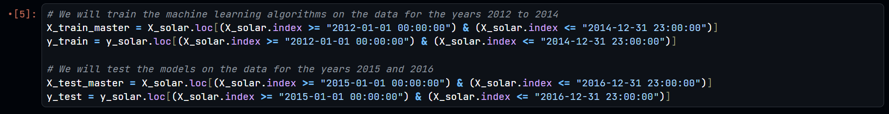
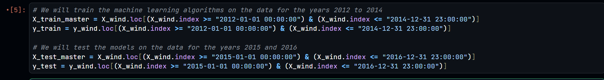
Training and Testing
Figure : Training and testing code of solar data
Figure : Training and testing code of wind data

Slide 23
Reference
[1] K. S. Perera, Z. Aung, and W. L. Woon, “Machine learning techniques for supporting renewable energy generation and integration: A survey,” in Data Analytics for Renewable Energy Integration: Second ECML PKDD Workshop, DARE 2014, Nancy, France, September 19, 2014, Revised Selected Papers 2, 2014, pp. 81–96.
[2] M. Sharifzadeh, A. Sikinioti-Lock, and N. Shah, “Machine-learning methods for integrated renewable power generation: A comparative study of artificial neural networks, support vector regression, and gaussian process regression,” in Renewable and Sustainable Energy Reviews, vol. 108, Elsevier, 2019, pp. 513–538.
[3] N. Sharma, P. Sharma, D. Irwin, and P. Shenoy, “Predicting solar generation from weather forecasts using machine learning,” in 2011 IEEE international conference on smart grid communications (SmartGridComm), 2011, pp. 528–533.

Slide 24
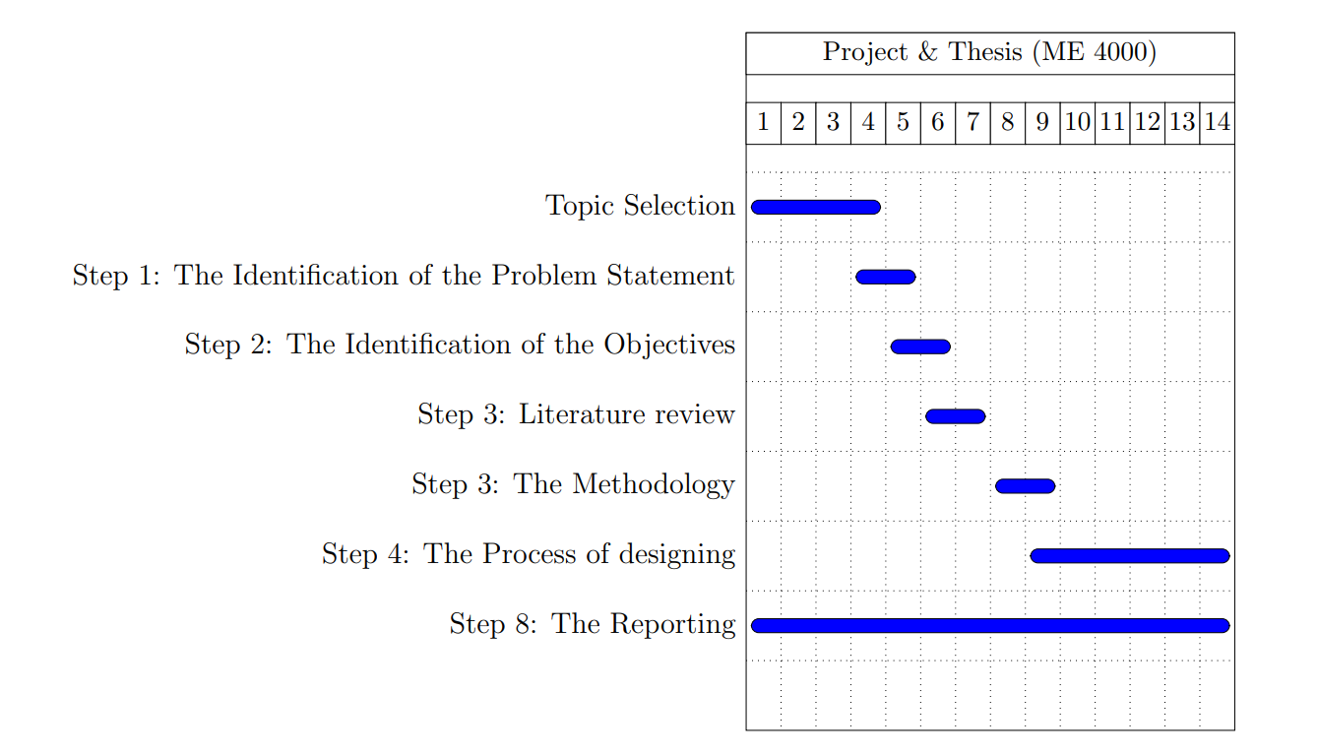
GANNT CHART

Slide 25
THANK YOU
PLEASE STATE YOUR VALUABLE COMMENTS AND QUESTIONS

